Slide 1
Learning Objective
I will be able to use the chain rule to determine the derivatives of composite functions
Success Criteria
At the end of the lesson, I will be able to:
use the chain rule to determine the derivatives of composite functions

Slide 2
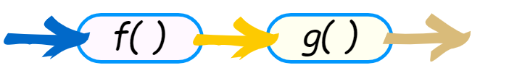


Composite Functions
Concept Development
Composite functions: Applying one function to the result of another
Example: Given $f\left(x\right)=2x+3,$ $g\left(x\right)=x^{2}$
$$g(2x+3)$$
$g(f\left(x\right))=$
$$={\left(2x+3\right)}^{2}$$

Slide 3


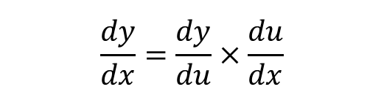



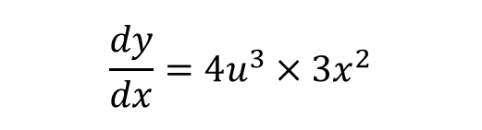
Skill Development – Method 1
Given $y={\left(x^{3}+1\right)}^{4}$, determine its derivative.
Let $u=x^{3}+1$
$$y=u^{4}$$
Typically, $y^{′}=\frac{dy}{dx}$
$$\frac{dy}{dx}=\frac{dy}{du}×\frac{du}{dx}$$
Leibniz Notation
$$\frac{dy}{du}=4u^{3}$$
$$\frac{du}{dx}=3x^{2}$$
$$\frac{dy}{dx}=4u^{3}×3x^{2}$$
Substi. $u=x^{3}+1, \frac{dy}{dx}=12x^{2}{(x^{3}+1)}^{3}$

Slide 4





Guided Practice
If $y=4u+3$ and $u=x^{2}−4$ determine $\frac{dy}{dx}$
$$y=4u+3$$
$$\frac{dy}{du}=4$$
$$u=x^{2}+4$$
$$\frac{du}{dx}=2x$$
NOTE: If we tried to substitute first, we would have
$$y = 4(x2 – 4) + 3$$
$$= 4x2 – 16 + 3$$
$$= 4x2 – 13$$
$$\frac{dy}{dx}=8x$$
$$\frac{dy}{dx}= \frac{dy}{du}×\frac{du}{dx}$$
$$\frac{dy}{dx}=4×2x$$
$$\frac{dy}{dx}=8x$$

Slide 5

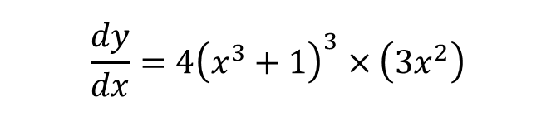
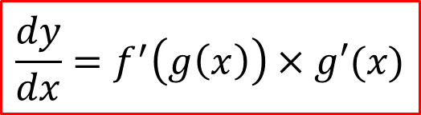
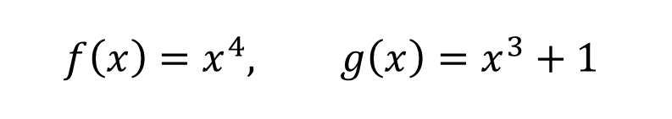
Skill Development – Method 2
Given $y={\left(x^{3}+1\right)}^{4}$, determine its derivative.
Let $y=f(g\left(x\right))$
$$\frac{dy}{dx}=f^{′}\left(g\left(x\right)\right)×g′(x)$$
In formula sheet
$$f\left(x\right)=x^{4}, g\left(x\right)=x^{3}+1$$
$$\frac{dy}{dx}=4{\left(x^{3}+1\right)}^{3}×\left(3x^{2}\right)$$
$$=12x^{2}{\left(x^{3}+1\right)}^{3}$$

Slide 6
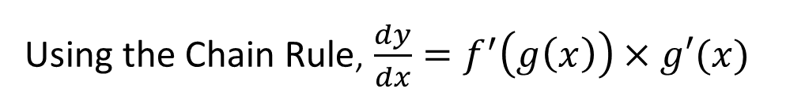


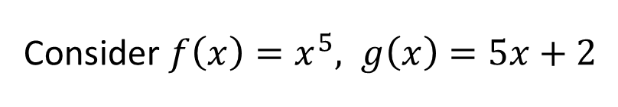
Guided Practice
Differentiate $y={\left(5x + 2\right)}^{5}$
Using the Chain Rule, $\frac{dy}{dx}=f^{′}\left(g\left(x\right)\right)×g′(x)$
Consider $f\left(x\right)=x^{5}, g\left(x\right)=5x+2$
$$\frac{dy}{dx}=5{\left(5x+2\right)}^{4}×5$$
$$=25{\left(5x+2\right)}^{4}$$

Slide 7
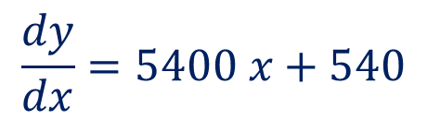
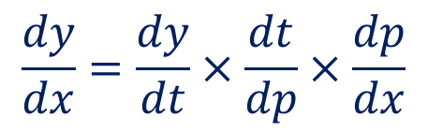
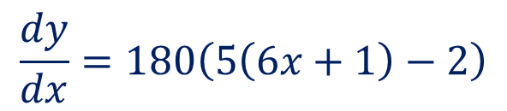

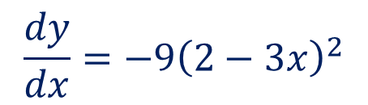
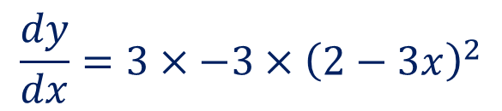

Guided Practice
Find $\frac{dy}{dx}$ in terms of $x$, given that $y=3t2$, $t=5p−2$and $p=6x+1$
Differentiate $y = (2 – 3x)3$
$$\frac{dy}{dx}=\frac{dy}{dt}×\frac{dt}{dp}×\frac{dp}{dx}$$
$$\frac{dy}{dx}=180\left(5\left(6x+1\right)−2\right)$$
$$\frac{dy}{dx}=6t×5×6$$
$$\frac{dy}{dx}=180t$$
$$\frac{dy}{dx}=5400 x+540$$
$$\frac{dy}{dx}=3×−3×{\left(2−3x\right)}^{2}$$
$$\frac{dy}{dx}=−9{\left(2−3x\right)}^{2}$$

Slide 8
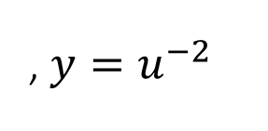
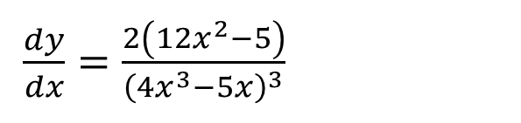
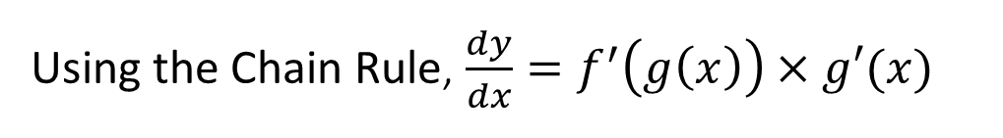

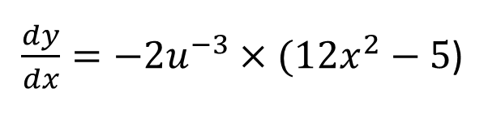

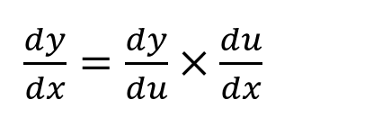
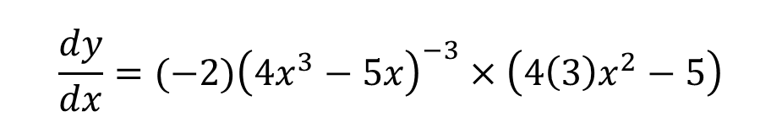
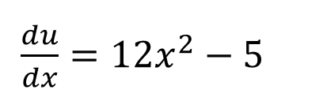

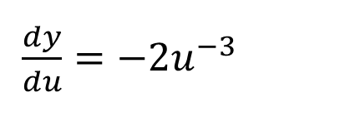
Guided Practice
Differentiate $y={\left(4x^{3}−5x\right)}^{−2}$
Let $u=4x^{3}−5x$
Using the Chain Rule, $\frac{dy}{dx}=f^{′}\left(g\left(x\right)\right)×g′(x)$
, $y=u^{−2}$
Consider $f\left(x\right)=x^{−2}, g\left(x\right)=4x^{3}−5x$
$\frac{dy}{du}=−2u^{−3}$
$$\frac{dy}{dx}=(−2){\left(4x^{3}−5x\right)}^{−3}×\left(4\left(3\right)x^{2}−5\right)$$
$\frac{du}{dx}=12x^{2}−5$
$$=−\frac{2\left(12x^{2}−5\right)}{{\left(4x^{3}−5x\right)}^{3}}$$
$\frac{dy}{dx}=\frac{dy}{du}×\frac{du}{dx}$
$\frac{dy}{dx}=−2u^{−3}×(12x^{2}−5$)
$\frac{dy}{dx}=\frac{2\left(12x^{2}−5\right)}{{\left(4x^{3}−5x\right)}^{3}}$

Slide 9
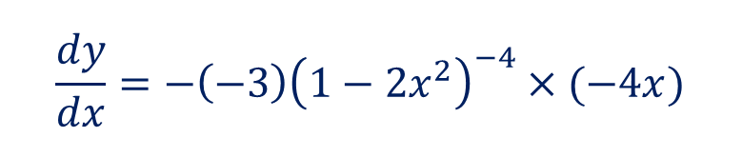
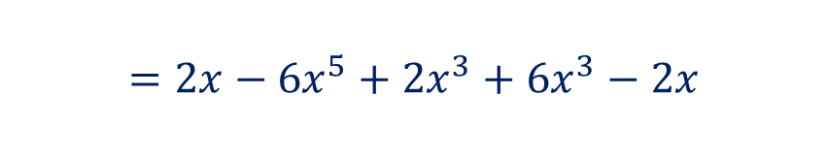
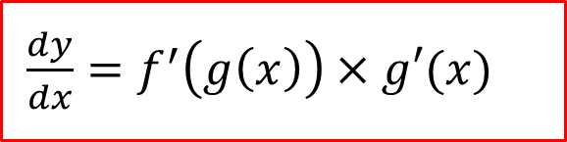
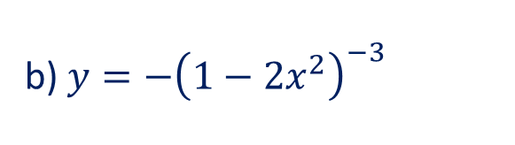
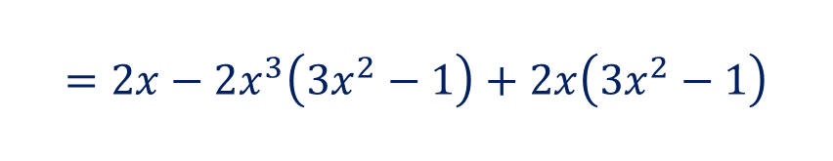
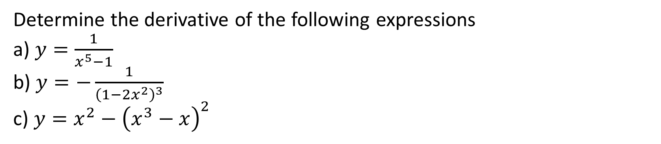

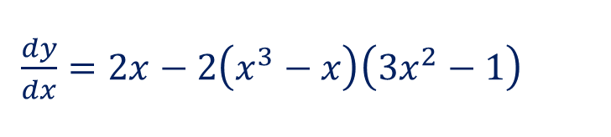
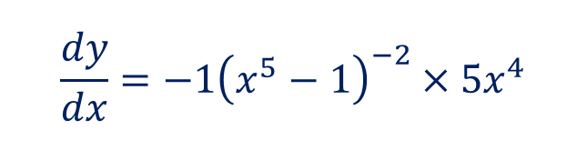
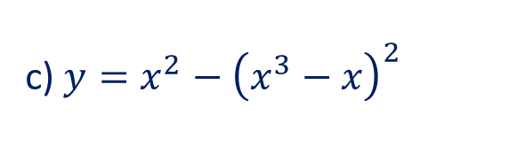

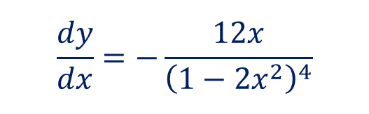

Guided Practice
$\frac{dy}{dx}=f^{′}\left(g\left(x\right)\right)×g′(x)$
Determine the derivative of the following expressions
a) $y=\frac{1}{x^{5}−1}$
b) $y=−\frac{1}{{\left(1−2x^{2}\right)}^{3}}$
c) $y=x^{2}−{\left(x^{3}−x\right)}^{2}$
c) $y=x^{2}−{\left(x^{3}−x\right)}^{2}$
a) $y={\left(x^{5}−1\right)}^{−1}$
$\frac{dy}{dx}=2x−2\left(x^{3}−x\right)\left(3x^{2}−1\right)$
$$\frac{dy}{dx}=−1{\left(x^{5}−1\right)}^{−2}×5x^{4}$$
$$=2x−2x^{3}\left(3x^{2}−1\right)+2x\left(3x^{2}−1\right)$$
$$=2x−6x^{5}+2x^{3}+6x^{3}−2x$$
$$=−\frac{5x^{4}}{{\left(x^{5}−1\right)}^{2}}$$
$$=−6x^{5}+8x^{3}$$
b) $y=−{\left(1−2x^{2}\right)}^{−3}$
$$\frac{dy}{dx}=−\left(−3\right){\left(1−2x^{2}\right)}^{−4}×(−4x)$$
$$\frac{dy}{dx}=−\frac{12x}{{\left(1−2x^{2}\right)}^{4}}$$

Slide 10



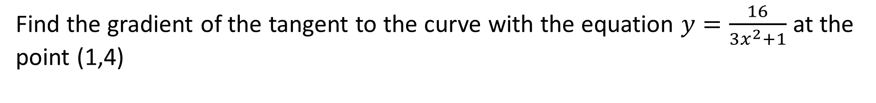

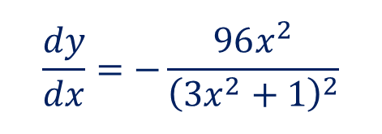
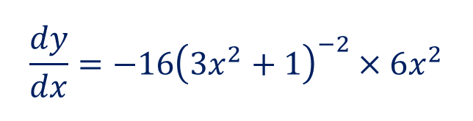
Guided Practice
Find the gradient of the tangent to the curve with the equation $y=\frac{16}{3x^{2}+1}$ at the point (1,4)
$$y=16{\left(3x^{2}+1\right)}^{−1}$$
$$\frac{dy}{dx}=−16{\left(3x^{2}+1\right)}^{−2}×6x^{2}$$
$$\frac{dy}{dx}=−\frac{96x^{2}}{{\left(3x^{2}+1\right)}^{2}}$$
Subst. x = 1, $\frac{dy}{dx}=−\frac{96{(1)}^{2}}{{\left(3{(1)}^{2}+1\right)}^{2}}$
$$=−\frac{96}{16}$$
$$=−6$$

Slide 11







Guided Practice
$\frac{dy}{dx}=f^{′}\left(g\left(x\right)\right)×g′(x)$
Given that $f^{′}\left(x\right)=\sqrt{3x+4}$ and $g\left(x\right)=x^{2}−1$, determine $h′(x)$, where $h\left(x\right)=f\left(g\left(x\right)\right)$
$$h′\left(x\right)=f^{′}\left(g\left(x\right)\right)×g′(x)$$
$$g^{′}\left(x\right)=2x$$
$$h′\left(x\right)=f^{′}\left(x^{2}−1\right)×2x$$
$$h^{′}(x)=\sqrt{3\left(x^{2}−1\right)+4}×2x$$
$$h^{′}(x)=2x\sqrt{3x^{2}+1}$$

Slide 12
Independent Practice
Complete Cambridge Ex 4E

